Slide 1
Project Alpha
Catalogue Page Code

Slide 2
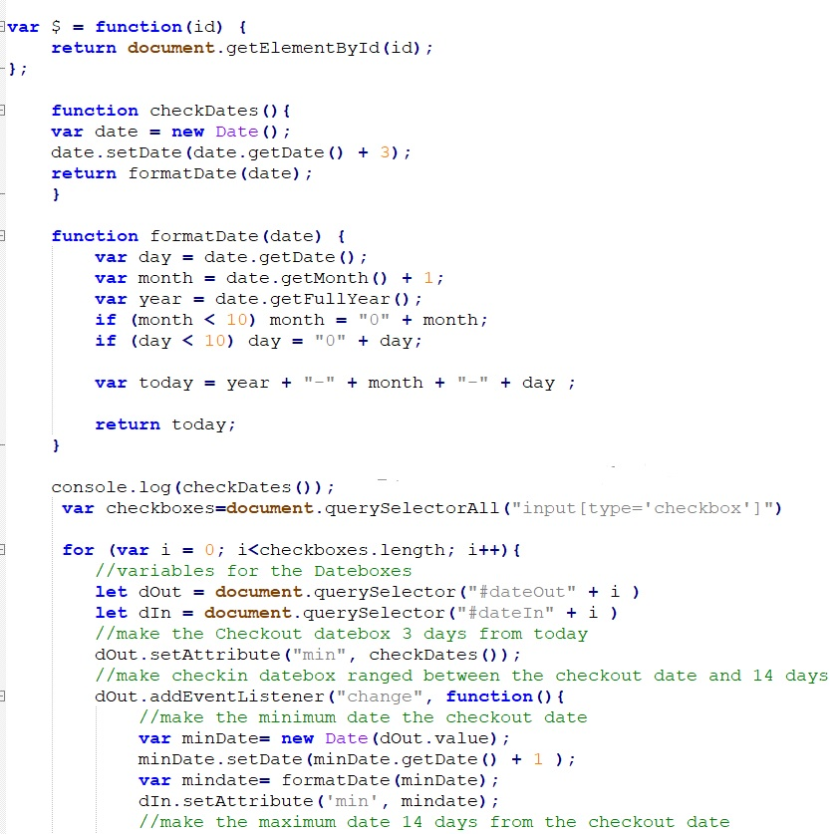
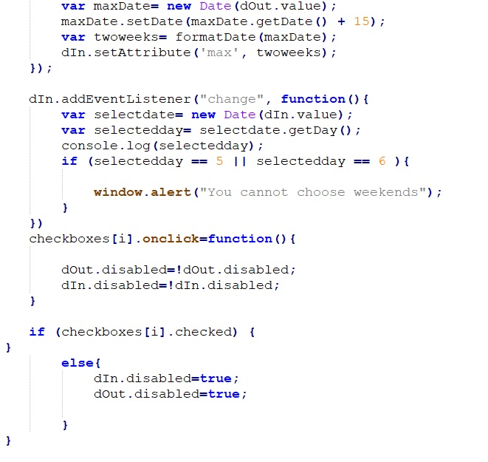

Slide 3
